Slide 1
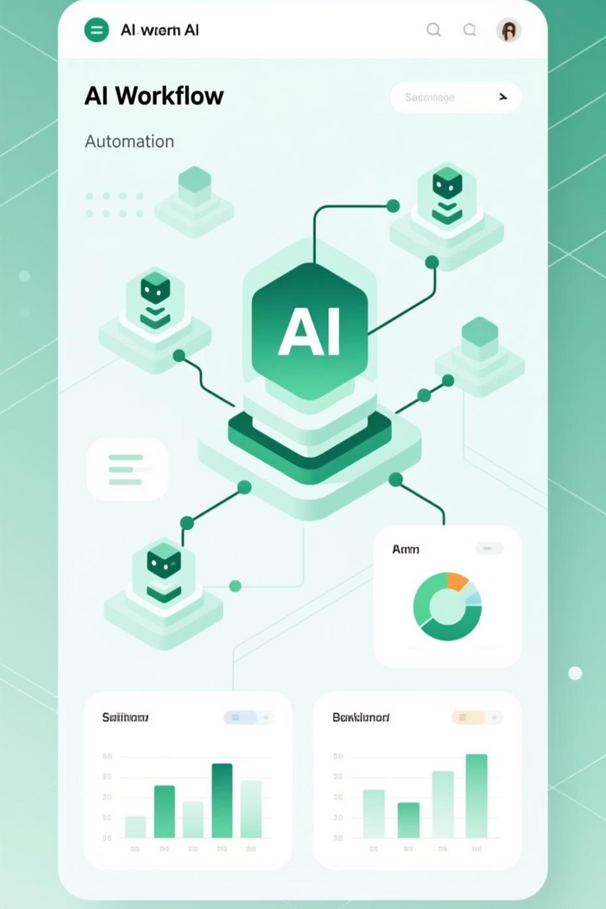

AI Agent Workflow
Automated News & Weather Briefing with
Intelligent Logging
P Lakshman
24071A05J6
Notes:
1

Slide 2

The Foundation: Docker & n8n
Docker Desktop
n8n Workflow Engine
Provides the container runtime environment for running applications in isolated, portable containers.
Open-source automation tool that connects apps, services, and databases without complex coding. Similar to Zapier but with greater flexibility and control.
Notes:
2

Slide 3
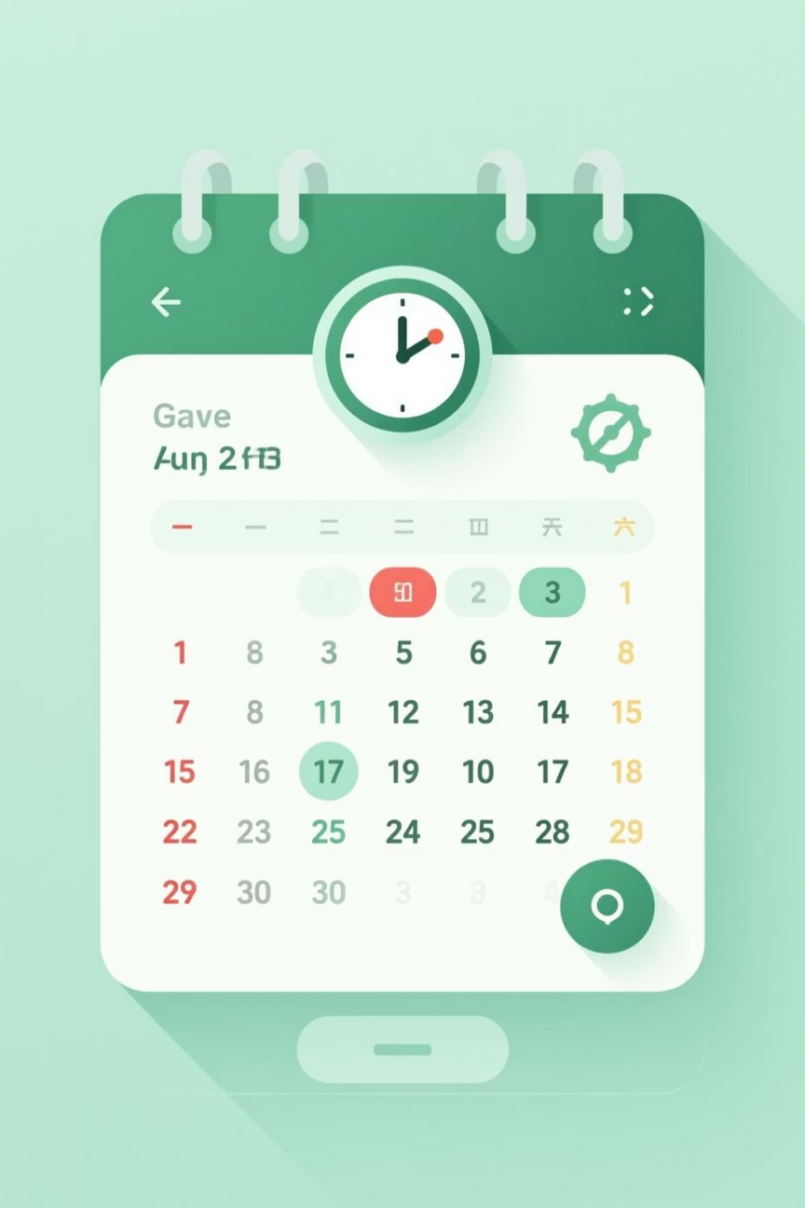
Workflow Trigger: Scheduled Automation
The workflow begins with a scheduled trigger that automatically initiates the process at predefined intervals—daily, hourly, or custom schedules—ensuring consistent, hands-free execution.
Notes:
3

Slide 4





The AI Agent: Multi-Source Intelligence
Google Gemini
Simple Memory
Wikipedia
Conversational AI for reasoning and intelligent processing
Retains context from past interactions
General knowledge queries and research
OpenWeatherMap
SerpAPI
Real-time weather data collection
Web search results and trending news
Notes:
4

Slide 5

Data Collection & Processing
The AI Agent intelligently gathers weather reports from OpenWeatherMap and news from Wikipedia and web sources, synthesizing multiple data streams into cohesive, actionable information.
Notes:
5

Slide 6

Formatting: Markdown to HTML
Markdown Conversion
HTML Styling
AI output is converted to Markdown format for structure and clarity.
Content is transformed into styled HTML with inline CSS for professional presentation and email compatibility.
Notes:
6

Slide 7

Delivery: Gmail Integration
Formatted content is automatically sent via Gmail, delivering daily or weekly briefings directly to users' inboxes with professional styling and complete information.
Notes:
7

Slide 8
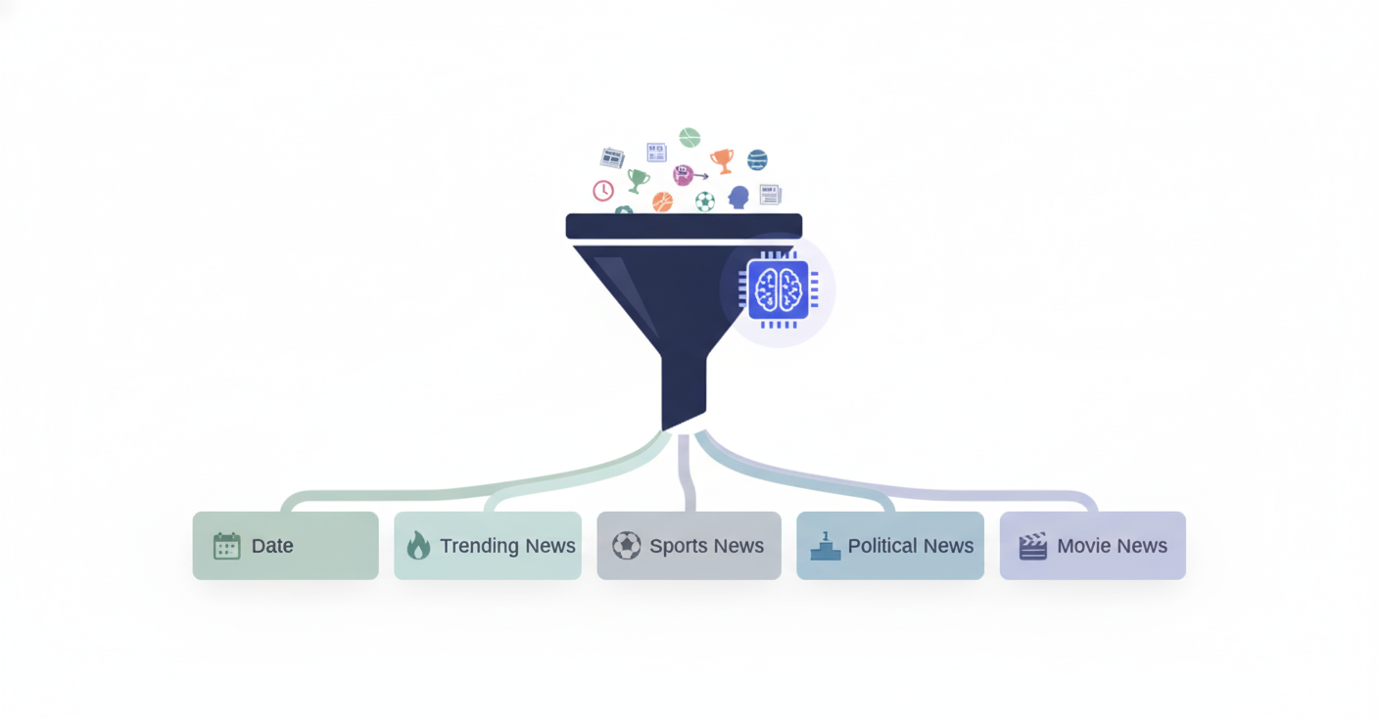
Intelligent Categorization
Date
1
Trending News
2
Sports News
3
Political News
4
Movie News
5
After email delivery, a secondary model categorizes all data into organized segments for structured logging and easy retrieval.
Notes:
8

Slide 9

Persistent Storage: Google Sheets
All processed information is automatically appended to a Google Sheet, creating a comprehensive historical log of every briefing generated. This enables tracking, analysis, and future reference of all automated reports.
Notes:
9

Slide 10

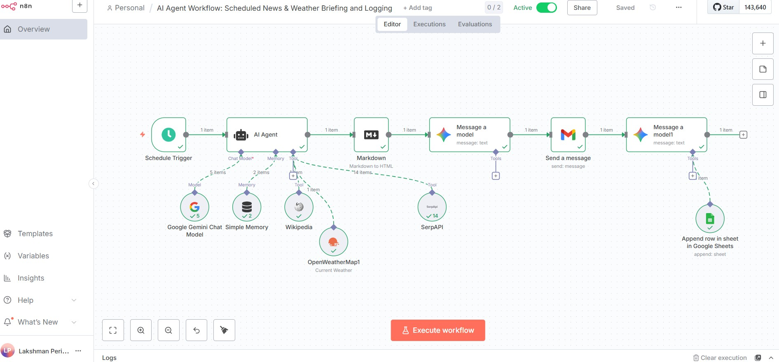
Complete Workflow Architecture
Schedule Trigger
Initiates workflow at predefined intervals
AI Agent
Gathers weather and news data
Format & Style
Converts to HTML with CSS
Send Email
Delivers via Gmail
Categorize & Log
Stores in Google Sheets
Notes:
10

Slide 11




The Automated Information Advantage: AI Agent Workflow for Reporting
Productivity in information delivery is revolutionized by automating repetitive tasks. This presentation outlines the significant advantages, current limitations, and future scope of leveraging an AI Agent Workflow for scheduled news and weather briefings, aiming for increased efficiency and superior reporting quality.
Automated Information Delivery
Centralized Integration
Eliminates manual effort with scheduled daily or hourly updates, ensuring timely distribution of critical information.
Seamlessly connects multiple data sources (Weather, Wikipedia, SerpAPI) using an orchestration tool like n8n for a unified workflow.
Consistent & Accurate Reporting
Dynamic Formatting
The AI ensures timely and precise summaries, drawing data exclusively from verified, reliable APIs.
Automatically converts raw AI output into professionally styled HTML, ready for presentation via email or web platforms.
Notes:
11

Slide 12

Addressing Current Limitations and Ensuring Robustness
While the AI agent workflow provides substantial advantages, addressing inherent dependencies and scaling challenges is crucial for enterprise adoption. We propose immediate solutions to enhance reliability and user experience.
Dependency on External APIs
Solution: Integrate fallback APIs and local caching mechanisms to maintain service continuity during third-party provider downtime.
Requires Internet Connectivity
Solution: Implement advanced error handling and aggressive retry logic to seamlessly manage transient network instability and temporary disconnections.
Limited AI Memory
Solution: Integrate a specialized database or vector store for efficient storage of past summaries, conversation context, or user preferences to maintain continuity.
No Direct User Interaction
Solution: Extend the core reporting engine with a dedicated chatbot or a lightweight web interface to facilitate real-time Q&A and immediate data retrieval.
Enhancing Reliability & Reach
By implementing technical safeguards and extending the system's interactive capabilities, we can move beyond a static reporting tool to a dynamic, resilient information hub.
Furthermore, the workflow includes smart categorization of news (Trending, Sports, Politics, Movies) and persistent logging of all records in a Google Sheet for auditing and future analysis.
Notes:
12

Slide 13









Future Scope: Scaling Intelligence and Interaction
The next phase of development focuses on transforming the automated briefing from a broadcast system into a highly personalized and interactive platform, maximizing value for end-users and providing deeper insights.
Personalized AI Briefings
Enable users to select topics (e.g., Sports, Politics) so the AI customizes daily updates specifically for their interests.
Voice-Based Briefings
Integrate text-to-speech capabilities to deliver audio summaries, making the system hands-free and more accessible.
Web Dashboard Integration
Develop a dedicated dashboard to display live news, weather, and logged data from Google Sheets, offering visual analytics and real-time monitoring.
Sentiment & Trend Analysis
Implement advanced models to analyze the mood and frequency of topics over time, identifying emerging trends and audience interests.
Chat Interface Extension
Allow users to query the AI directly via popular chat platforms (Telegram/WhatsApp) for instant responses to data requests.
Enhanced Logging & Insights
Automatically convert the raw Google Sheets log data into actionable visual charts and reports, helping track daily patterns and engagement metrics.
Notes:
13

